Slide 1
Natural Language to SQL Patterns
Database schema inference
Dynamic table selection
Retrieval-Augmented generation
Fine-tuning

Slide 2



Pattern 1: Database schema inference
I provided the LLM with the schema of the database in the prompt. The schema is a description of the database structure, including table names, columns and relationships and a few rows. This way, the LLM has more context to work with.
Positives:
Suits for processing smaller datasets.
Simple to use
Negatives:
Whole database schema in the prompt
Hallucinations
Wrong results
Prepare answer in natural language
Execute query against database
SQL query build
Db schema with default prompt/
Custom prompt
User
Azure OpenAI
GPT-4-32k

Slide 3

Pattern 2: Dynamic relevant table selection
I provided the LLM with the tables descriptions of the database to the pydantic function to extract relevant tables. Send schema of the selected tables to LLM to construct SQL query.
Tables & descriptions
Positives:
Suits for processing bigger databases.
Send schema in the prompt only for the tables needed
Negatives:
Prompt size bigger since we sending table descriptions
Prepare answer in natural language
Execute query against database
SQL query build
Filter tables
User
Azure OpenAI
GPT-4-32k

Slide 4

Pattern 3: Retrieval-Augmented Generation (RAG) Pattern
Section 1
Embedding 1
Tables & Metadata
Section 2
Embedding 2
Azure AI Search
Section 3
Azure OpenAI
Embedding 3
Column
Index
Table
Index
Section 4
Text-embedding-ada-002
Embedding 4
Positives:
Suited for large databases with 100s/1000s of tables.
No need to send entire database schema.
Semantic ranker to bring relevant tables and columns at the top.
Control with context
Negatives:
Context collection – tables, descriptions, columns, column descriptions, relationships..etc
Dataset evaluation
Might bring unnecessary tables and columns.
Possible Improvements:
Self-correction of queries
Few-shot
Columns & Metadata
3
2
7
6
5
4
Prepare answer in natural language
Execute query
SQL query build
Filtered tables & columns filters
N Relevant
Columns
N Relevant Tables
1
User
Azure OpenAI
GPT-4-32k

Slide 5
Pattern 4: Fine-tuning
1: Improve current methods
Focus on optimizing semantic search and prompt engineering
Test, evaluate, test, evaluate…
Consider self correction methods
2: Model fine-tuning
High accuracy
It will be expensive
Needs a lot of training data, validation data
3. Observations
RAG should be the choice
RAG with tables metadata, columns metadata + examples + few-shot might improve results
Langchain Agents to improve further???

Slide 6
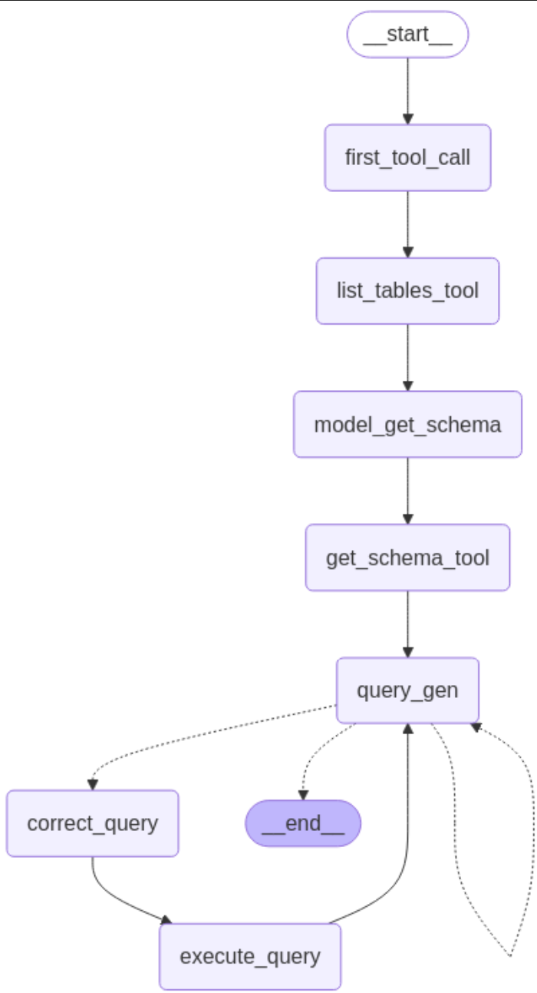
Pattern 5: Agentic AI ….(in progress)
Work In progress (2 patterns)
Do the whole schema inference, the one described on picture
Use agentic ai with RAG for databases with 100s/1000s of tables

